Slide 1
UNIT – 4
Signals :
Signals: The UNIX Kernel Support for Signals,
signal,
Signal Mask,
sigaction,
The SIGCHLD Signal and waitpid API,
The sigsetjmp and siglongjmp Functions,
kill,
alarm,
Interval Timers.
Daemon Process :
Introduction,
Daemon Characteristics,
Coding Rules,
Error Logging,
Client- Server Model

Slide 2
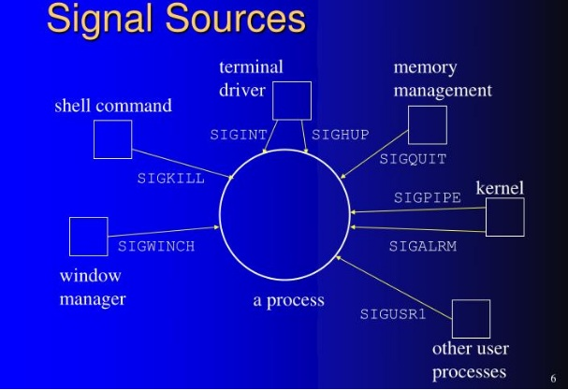

Slide 3
SIGNALS AND DAEMON PROCESSES
SIGNALS
Signals are software interrupts.
Signals provide a way of handling asynchronous events: a user at a terminal typing the interrupt key to stop a program or the next program in a pipeline terminating prematurely.
When a signal is sent to a process, it is pending on the process to handle it. The process can react to pending signals in one of three ways:
Accept the default action of the signal, which for most signals will terminate the process.
Ignore the signal. The signal will be discarded and it has no affect whatsoever on the
recipient process.
Invoke a user-defined function. The function is known as a signal handler routine and the signal is said to be caught when this function is called.

Slide 4
SIGNALS AND DAEMON PROCESSES
SIGNALS
Name | Description | Default action
SIGABRT | abnormal termination (abort) | terminate+core
SIGALRM | timer expired (alarm) | terminate
SIGCHLD | change in status of child | ignore
SIGCONT | continue stopped process | continue/ignore
SIGFPE | arithmetic exception | terminate+core
SIGINT | terminal interrupt character | terminate
SIGIO | asynchronous I/O | terminate/ignore
SIGKILL | termination | terminate
SIGPIPE | write to pipe with no readers | terminate
SIGQUIT | terminal quit character | terminate+core
SIGSEGV | invalid memory reference | terminate+core
SIGSTOP | stop | stop process
240

Slide 5
SIGNALS AND DAEMON PROCESSES
SIGNALS
Name | Description | Default action
SIGTTOU | background write to control tty | stop process
SIGUSR1 | user-defined signal | Terminate
SIGUSR2 | user-defined signal | Terminate
SIGTERM | termination | Terminate
SIGTSTP | terminal stop character | stop process
SIGTTIN | background read from control tty | stop process

Slide 6
SIGNALS AND DAEMON PROCESSES
SIGNALS
THE UNIX KERNEL SUPPORT OF SIGNALS
When a signal is generated for a process, the kernel will set the corresponding
signal flag in the process table slot of the recipient process.
If the recipient process is asleep, the kernel will awaken the process by scheduling it.
When the recipient process runs, the kernel will check the process U-area that contains an array of signal handling specifications.
If array entry contains a zero value, the process will accept the default action of the signal.
If array entry contains a 1 value, the process will ignore the signal and kernel will
discard it.
If array entry contains any other value, it is used as the function pointer for a user- defined signal handler routine.

Slide 7
SIGNALS AND DAEMON PROCESSES
SIGNALS
The function prototype of the signal API is:
#include <signal.h>
void (*signal(int sig_no, void (*handler)(int)))(int);
Returns: previous disposition of signal (see following) if OK, SIG_ERR on error The formal argument of the API are:
sig_no is a signal identifier like SIGINT or SIGTERM.
The handler argument is the function pointer of a user-defined signal handler function.

Slide 8
SIGNALS AND DAEMON PROCESSES
SIGNALS
The function prototype of the signal API is:
#include <signal.h>
void (*signal(int sig_no, void (*handler)(int)))(int);
The sig_no argument is just the name of the signal.
The value of handler is
the constant SIG_IGN,
the constant SIG_DFL, or
the address of a function to be called when the signal occurs.

Slide 9
SIGNALS AND DAEMON PROCESSES
SIGNALS
The function prototype of the signal API is:
#include <signal.h>
void (*signal(int sig_no, void (*handler)(int)))(int);
If we specify SIG_IGN, we are telling the system to ignore the signal.
(Remember that we cannot ignore the two signals SIGKILL and SIGSTOP)
When we specify SIG_DFL, we are setting the action associated with the signal to its default value.
When we specify the address of a function to be called when the signal occurs, we are arranging to "catch" the signal. We call the function either the signal handler or the signal-catching function.

Slide 10
SIGNALS AND DAEMON PROCESSES
SIGNALS
The function prototype of the signal API is:
#include <signal.h>
void (*signal(int sig_no, void (*handler)(int)))(int);
The prototype for the signal function states that the function requires two arguments
and returns a pointer to a function that returns nothing (void).
The signal function's first argument, sig_no, is an integer.
The second argument is a pointer to a function that takes a single integer argument and
returns nothing.
The function whose address is returned as the value of signal takes a single integer argument (the final (int)).

Slide 11
SIGNALS AND DAEMON PROCESSES
SIGNALS
The function prototype of the signal API is:
#include <signal.h>
void (*signal(int sig_no, void (*handler)(int)))(int);
If we examine the system's header <signal.h>, we probably find declarations of the form #define SIG_ERR (void (*)())-1
#define SIG_DFL (void (*)())0
#define SIG_IGN (void (*)())1
These constants can be used in place of the "pointer to a function that takes an integer argument and returns nothing," the second argument to signal, and the return value from signal.
The three values used for these constants need not be -1, 0, and 1.
They must be three values that can never be the address of any declarable function.

Slide 12
SIGNALS AND DAEMON PROCESSES
SIGNALS
The following example attempts to catch the SIGTERM signal, ignores the SIGINT signal,
and accepts the default action of the SIGSEGV signal. The pause API suspends the calling process until it is interrupted by a signal and the corresponding signal handler does a return:
#include<iostream.h> #include<signal.h> /*signal handler function*/ void catch_sig(int sig_num) { signal (sig_num,catch_sig); cout<<”catch_sig:”<<sig_num<<endl; } | int main() /*main function*/ { signal(SIGTERM,catch_sig); signal(SIGINT,SIG_IGN); signal(SIGSEGV,SIG_DFL); pause( );/*wait for a signal interruption*/ }
The SIG_IGN specifies a signal is to be ignored, which means that if the signal is generated to the process,
it will be discarded without any interruption of the process.

Slide 13
SIGNALS AND DAEMON PROCESSES
SIGNALS
#include<stdio.h> #include<signal.h> /*signal handler function*/ static void sig_usr(int signo) /* arg is signal number */ { if (signo == SIGUSR1) printf("received SIGUSR1\n"); else if (signo == SIGUSR2) printf("received SIGUSR2\n"); else printf("received signal %d\n", signo); } | int main(void) { if (signal(SIGUSR1, sig_usr) == SIG_ERR) perror("can't catch SIGUSR1"); if (signal(SIGUSR2, sig_usr) == SIG_ERR) perror("can't catch SIGUSR2"); for ( ; ; ) pause(); }

Slide 14
SIGNALS AND DAEMON PROCESSES
SIGNALS
$ ./a.out &
[1] 7216
$ kill -USR1 7216 received SIGUSR1
$ kill -USR2 7216
received SIGUSR2
$ kill 7216
start process in background
job-control shell prints job number and process ID send it SIGUSR1
send it SIGUSR2
now send it SIGTERM
[1]+ Terminated ./a.out
When we send the SIGTERM signal, the process is terminated, since it doesn't catch the signal, and the default action for the signal is termination.
250

Slide 15
SIGNALS AND DAEMON PROCESSES
SIGNALS
kill and raise Functions
The kill function sends a signal to a process or a group of processes.
The raise function allows a process to send a signal to itself.
#include <signal.h>
int kill(pid_t pid, int signo); int raise(int signo);
Both return: 0 if OK, –1 on error The call
raise(signo);
is equivalent to the call kill(getpid(), signo);

Slide 16
SIGNALS AND DAEMON PROCESSES
SIGNALS
kill and raise Functions
#include <signal.h>
int kill(pid_t pid, int signo);
There are four different conditions for the pid argument to kill.
Pid value | Meaning
Pid > 0 | The signal is sent to the process whose process ID is pid.
Pid==0 | The signal is sent to all processes whose process group ID equals the process group ID of the sender and for which the sender has permission to send the signal.
Pid<0 | The signal is sent to all processes whose process group ID equals the absolute value of pid and for which the sender has permission to send the signal.
Pid==-1 | The signal is sent to all processes on the system for which the sender has permission to send the signal.

Slide 17
SIGNALS AND DAEMON PROCESSES
#include<iostream.h>
#include<signal.h>
Void handler(int);
Int main()
{
int pid;
If((pid=fork())==0)
{
singal (SIGINT,SIG_DFL);
Sleep(2);
}
else
{
kill(pid, SIGINT);
sleep(5);
Cout<“parent exiting”;
}
Void handler()
{
cout<<“signal received by child”;
}

Slide 18
SIGNALS AND DAEMON PROCESSES
SIGNALS
alarm and pause Functions
The alarm function allows us to set a timer that will expire at a specified time in the
future.
When the timer expires, the SIGALRM signal is generated.
If we ignore or don't catch this signal, its default action is to terminate the process.
#include <unistd.h>
unsigned int alarm(unsigned int seconds);
Returns: 0 or number of seconds until previously set alarm.
The seconds value is the number of clock seconds in the future when the signal should be generated.

Slide 19
SIGNALS AND DAEMON PROCESSES
SIGNALS
alarm and pause Functions
#include <unistd.h>
unsigned int alarm(unsigned int seconds);
If, when we call alarm, a previously registered alarm clock for the process has not yet expired, the number of seconds left for that alarm clock is returned as the value of this function.
That previously registered alarm clock is replaced by the new value.
If a previously registered alarm clock for the process has not yet expired and if the seconds value is 0, the previous alarm clock is canceled.
The number of seconds left for that previous alarm clock is still returned as the value of the function.
Although the default action for SIGALRM is to terminate the process, most processes that use an alarm clock catch this signal.

Slide 20
This is very important in view of the exams…. Okay so don’t forget this
#include<iostream.h>
#include<signal.h>
Using namespace std;
Void sleep(int i);
{
alarm(i);
pause();
}
Int main()
{
cout<<“amit is waiting”;
sleep(5);
Cout<“amit finished waiting”;
Return 0;
}

Slide 21
SIGNALS AND DAEMON PROCESSES
SIGNALS
alarm and pause Functions
The pause function suspends the calling process until a signal is caught.
#include <unistd.h> int pause(void);
Returns: –1 with errno set to EINTR
The only time pause returns is if a signal handler is executed and that handler returns.
In that case, pause returns –1 with errno set to EINTR.

Slide 22
SIGNALS AND DAEMON PROCESSES
SIGNALS
alarm and pause Functions
Using alarm and pause, we can put a process to sleep for a specified amount of time. The sleep() can be implemented using alarm() and pause().
#include <signal.h> #include <unistd.h> static void sig_alrm(int signo) { /* nothing to do, just return to wake up the pause */ } | unsigned int sleep(unsigned int nsecs) { if (signal(SIGALRM, sig_alrm) == SIG_ERR) return(nsecs); alarm(nsecs); /* start the timer */ pause(); /* next caught signal wakes us up */ return(alarm(0)); /* turn off timer, return unslept time */ }

Slide 23
SIGNALS AND DAEMON PROCESSES
SIGNALS
SIGNAL SETS
We need a data type to represent multiple signals—a signal set
POSIX.1 defines the data type sigset_t to contain a signal set and the following five functions to manipulate signal sets.
#include <signal.h>
int sigemptyset(sigset_t *set); int sigfillset(sigset_t *set);
int sigaddset(sigset_t *set, int signo); int sigdelset(sigset_t *set, int signo);
Returns: 0 if OK, -1 on error.

Slide 24
SIGNALS AND DAEMON PROCESSES
SIGNALS
SIGNAL MASK
Signal mask of a process is the set of signals currently blocked from delivery to that process.
A process initially inherits the parent’s signal mask when it is created, but any pending signals for the parent process are not passed on.
A process may query or set its signal mask via the sigprocmask API:
#include <signal.h>
int sigprocmask(int cmd, const sigset_t *new_mask, sigset_t *old_mask);
Returns: 0 if OK, -1 on error
.
260

Slide 25
SIGNALS AND DAEMON PROCESSES
SIGNALS
SIGNAL MASK
The new_mask argument defines a set of signals to be set or reset in a calling process signal mask, and the cmd argument specifies how the new_mask value is to be used by the API.
The possible values of cmd and the corresponding use of the new_mask value are:
.
Cmd value | Meaning
SIG_SETMASK | Overrides the calling process signal mask with the value specified in the new_mask argument.
SIG_BLOCK | Adds the signals specified in the new_mask argument to the calling process signal mask.
SIG_UNBLOCK | Removes the signals specified in the new_mask argument from the calling process signal mask.
261

Slide 26
SIGNALS AND DAEMON PROCESSES
SIGNALS
SIGNAL MASK
The following example checks whether the SIGINT signal is present in a process signal mask and adds it to the mask if it is not there. Then clears the SIGSEGV signal from the process signal mask.
 | #include <stdio.h> #include <signal.h> int main() { sigset_t mask; sigemptyset(&mask); /*initialize set*/ if (sigprocmask(0, 0, &mask) == -1) { /*get current signal mask*/ perror(“sigprocmask”); exit(1); } | else sigaddset(&mask, SIGINT); /*set SIGINT flag*/ sigdelset(&mask, SIGSEGV); /*clear SIGSEGV flag*/ if (sigprocmask(SIG_SETMASK, &mask, 0) == -1) perror(“sigprocmask”); /*set a new signal mask*/ } .
262

Slide 27
SIGNALS AND DAEMON PROCESSES
SIGNALS
SIGNAL MASK
The program prints the names of the signals in the signal mask of the calling process
#include <stdio.h> #include <signal.h> int main() { sigset_t sigset; sigemptyset(&sigset); /*initialize set*/ if (sigprocmask(0, NULL, &sigset) < 0) perror("sigprocmask error"); | if (sigismember(&sigset, SIGINT)) printf("SIGINT "); if (sigismember(&sigset, SIGQUIT)) printf("SIGQUIT "); if (sigismember(&sigset, SIGUSR1)) printf("SIGUSR1 "); if (sigismember(&sigset, SIGALRM)) printf("SIGALRM "); }

Slide 28
SIGNALS AND DAEMON PROCESSES
SIGNALS
SIGPENDING FUNCTION
The sigpending function returns the set of signals that are blocked from delivery and currently pending for the calling process.
The set of signals is returned through the set argument
#include <signal.h>
int sigpending(sigset_t
*set);
Returns: 0 if OK, –1 on error.

Slide 29
SIGNALS AND DAEMON PROCESSES
SIGNALS
SIGPENDING FUNCTION
The process blocks SIGQUIT, saving its current signal mask (to reset later), and then goes to sleep for 5 seconds.
Any occurrence of the quit signal during this period is blocked and won't be delivered until the signal is unblocked.
At the end of the 5-second sleep, we check whether the signal is pending and unblock the signal.

Slide 30
SIGNALS AND DAEMON PROCESSES
SIGNALS - SIGPENDING FUNCTION
 | #include <signal.h> #include <unistd.h> static void sig_quit(int signo) { printf("caught SIGQUIT\n"); if (signal(SIGQUIT, SIG_DFL) == SIG_ERR) perror("can't reset SIGQUIT"); } int main(void) { sigset_t newmask, oldmask, pendmask; if (signal(SIGQUIT, sig_quit) == SIG_ERR) perror("can't catch SIGQUIT"); /* Block SIGQUIT and save current signal mask*/ sigemptyset(&newmask); | if (sigprocmask(SIG_BLOCK, &newmask, &oldmask) < 0) perror("SIG_BLOCK error"); sleep(5); /* SIGQUIT here will remain pending */ if (sigpending(&pendmask) < 0) perror("sigpending error"); if (sigismember(&pendmask, SIGQUIT)) printf("\nSIGQUIT pending\n"); /* Reset signal mask which unblocks SIGQUIT*/ if (sigprocmask(SIG_SETMASK, &oldmask, NULL) < 0) perror("SIG_SETMASK error"); printf("SIGQUIT unblocked\n"); sleep(5); /* SIGQUIT here will terminate with core file */ exit(0);
 | sigaddset(&newmask, SIGQUIT); | }
PROF.
SYED MUSTAFA, HKBKCE 266

Slide 31
SIGNALS AND DAEMON PROCESSES
SIGNALS
Sigaction() Function
The sigaction() function allows us to examine or modify (or both) the action associated with a particular signal.
This function supersedes the signal() function from earlier releases of the UNIX System.
#include <signal.h>
int sigaction(int signo, const struct sigaction *restrict act, struct sigaction *restrict oact);
Returns: 0 if OK, –1 on error

Slide 32
SIGNALS AND DAEMON PROCESSES
SIGNALS
sigaction() Function
The sigaction API is a replacement for the signal API in the latest UNIX and POSIX systems.
The sigaction API is called by a process to set up a signal handling method for each signal it wants to deal with.
sigaction API returns the previous signal handling method for a given signal.

Slide 33
SIGNALS AND DAEMON PROCESSES
SIGNALS
sigaction() Function
The struct sigaction data type is defined in the <signal.h> header as
struct sigaction
{
void (*sa_handler)(int); sigset_t sa_mask;
int sa_flags;
}
/* addr of signal handler, or SIG_IGN, or SIG_DFL */
/* additional signals to block */
/* signal options */

Slide 34
SIGNALS AND DAEMON PROCESSES
SIGNALS
sigaction() Function
The sa_handler field can be set to SIG_IGN, SIG_DFL, or a user defined signal handler function.
The sa_mask field specifies additional signals that process wishes to block when it is handling signo signal.
The signalno argument designates which signal handling action is defined in the action argument.
The previous signal handling method for signalno will be returned via the
oldaction argument if it is not a NULL pointer.
If action argument is a NULL pointer, the calling process‘s existing signal handling method for signalno will be unchanged.
270

Slide 35
SIGNALS AND DAEMON PROCESSES
SIGNALS - sigaction FUNCTION
#include <signal.h> #include <iostream.h> void callme ( int sig_num ) { cout <<“catch signal:”<<sig_num<< endl; } int main(void) { sigset_t sigmask; struct sigaction action, old_action; sigemptyset(&sigmask); | if ( sigaddset( &sigmask, SIGTERM) == -1 || sigprocmask( SIG_SETMASK, &sigmask, 0) == -1) perror(“Set signal mask”); sigemptyset( &action.sa_mask); sigaddset( &action.sa_mask, SIGSEGV); action.sa_handler = callme; action.sa_flags = 0; if (sigaction (SIGINT, &action, &old_action) == -1) perror(“sigaction”); pause(); /* wait for signal interruption*/ return 0; }

Slide 36
SIGNALS AND DAEMON PROCESSES
SIGNALS - sigaction FUNCTION
In the program, the process signal mask is set with SIGTERM signal.
The process then defines a signal handler for the SIGINT signal and also specifies that the SIGSEGV signal is to be blocked when the process is handling the SIGINT signal.
The process then terminates its execution via the pause API.

Slide 37
SIGNALS AND DAEMON PROCESSES
SIGNALS
THE SIGCHLD SIGNAL AND THE waitpid API
When a child process terminates or stops, the kernel will generate a SIGCHLD signal to its parent process. Depending on how the parent sets up the handling of the SIGCHLD signal, different events may occur:
Parent accepts the default action of the SIGCHLD signal:
SIGCHLD does not terminate the parent process.
Parent process will be awakened.
API will return the child’s exit status and process ID to the parent.
Kernel will clear up the Process Table slot allocated for the child process.
Parent process can call the waitpid API repeatedly to wait for each child it created.

Slide 38
SIGNALS AND DAEMON PROCESSES
SIGNALS
THE SIGCHLD SIGNAL AND THE waitpid API
Parent ignores the SIGCHLD signal:
SIGCHLD signal will be discarded.
Parent will not be disturbed even if it is executing the waitpid system call.
If the parent calls the waitpid API, the API will suspend the parent until all its child processes have terminated.
Child process table slots will be cleared up by the kernel.
API will return a -1 value to the parent process.
Process catches the SIGCHLD signal:
The signal handler function will be called in the parent process whenever a child process terminates.
If the SIGCHLD arrives while the parent process is executing the waitpid system call, the waitpid API may be restarted to collect the child exit status and clear its process table slots.
Depending on parent setup, the API may be aborted and child process table slot not freed.

Slide 39
The sigsetjmp and siglongjmp APIs:
The sigsetjmp and siglongjmp APIs have similar functions as their corresponding setjmp and longjmp APIs.
These are used to transfer control from one function to another hence they are called non-local goto statements. The function prototype of these functions are:
#include <setjmp.h>
int sigsetjmp(sigjmp_buf jmpb, int save_sigmask );
void longjmp(sigjmp_buf jmpb, int retval);

Slide 40
The sigsetjmp behaves similarly to the setjmp APIs, except that it has a second argument, save_sigmask, which allows a user to specify whether a calling process signal mask should be saved to the provided env argument.
Similarly the siglongjmp does all the operations as the longjmpAPI, but it also restores a calling process signal mask if the mask was saved in its env argument.
The retval argument specifies the return value of the corresponding sigsetjmp API when it is called by siglongjmp. It value should be a non-zero number, if it is zero the siglongjmp API will reset it to 1.
The siglongjmp API is usually called from user defined signal handling functions

Slide 41
SIGNALS AND DAEMON PROCESSES
SIGNALS
abort() Function
abort function causes abnormal program termination
#include <stdlib.h> void abort(void);
This function never returns.
This function sends the SIGABRT signal to the caller. Processes should not ignore this signal.
ISO C states that calling abort will deliver an unsuccessful termination notification to the
host environment by calling raise(SIGABRT).

Slide 42
SIGNALS AND DAEMON PROCESSES
SIGNALS
system() Function
#include <stdlib.h>
int system(const char *command);
This function returns is -1 on error.
If the value of command is NULL, system() returns nonzero if the shell is available, and zero if not.
system() executes a command specified in command by calling /bin/sh -c command, and returns after the command has been completed. During execution of the
command, SIGCHLD will be blocked, and SIGINT and SIGQUIT will be ignored
Eg: system(“ls –l”);

Slide 43
SIGNALS AND DAEMON PROCESSES
SIGNALS
sleep() Function
sleep - sleep for the specified number of seconds
#include <unistd.h>
unsigned int sleep(unsigned int seconds);
Returns: 0 or number of unslept seconds.
This function causes the calling process to be suspended until either
The amount of wall clock time specified by seconds has elapsed.
A signal is caught by the process and the signal handler returns.
Eg:
sleep(60); // suspend the process for one minute.

Slide 44
Interval timers
We know that, sleep( ) API is constructed using the alarm( ) and pause( ) APIs.
But sleep( ) API just suspends a process for a fixed amount of time.
Other than this, the alarm( ) API can also be used to set up an interval timer.
The interval timer is used to schedule a process to do some tasks at a fixed time interval.
#include <sys/time.h>
int getitimer(int which, struct itimerval *value);
int setitimer(int which, const struct itimerval *value, struct itimerval *ovalue);

Slide 45
struct itimerval
{
struct timeval it_interval; /* next value */
struct timeval it_value; /* current value */
};
struct timeval
{
long tv_sec; /* seconds */
long tv_usec; /* microseconds */
};

Slide 46
Tag | Description
ITIMER_REAL | decrements in real time, and delivers SIGALRM upon expiration.
ITIMER_VIRTUAL | decrements only when the process is executing, and delivers SIGVTALRM upon expiration.
ITIMER_PROF | decrements both when the process executes and when the system is executing on behalf of the process. Coupled with ITIMER_VIRTUAL, this timer is usually used to profile the time spent by the application in user and kernel space. SIGPROF is delivered upon expiration

Slide 47
Sample questions
What is signal API? Explain the various signal names and their purpose.
What is signalmask? Explain with the syntax and a sample program.
Explain the sigaction( ) function.
Explain the various ways in which a parent can handle different signals when a child process terminates or stops.
With the syntax, explain the concept of sigsetjmp ( ) & siglongjmp ( ) functions.
Explain the kill and alarm API with syntax.
Write a note on interval times.
Explain the various signal sets with the sytax.
Explain the sleep and abort API with syntax.

Slide 48
DAEMON PROCESSES
Introduction
Daemon characteristics
Coding rules for creating daemons
Error Logging
Client – Server Model

Slide 49
DAEMON PROCESSES
DAEMON PROCESSES
Daemons are processes that live for a long time.
They are often started when the system is bootstrapped and terminate only when the system is shut down.
Because they don't have a controlling terminal, we say that they run in the background.
UNIX systems have numerous daemons that perform day-to-day activities.
280

Slide 50
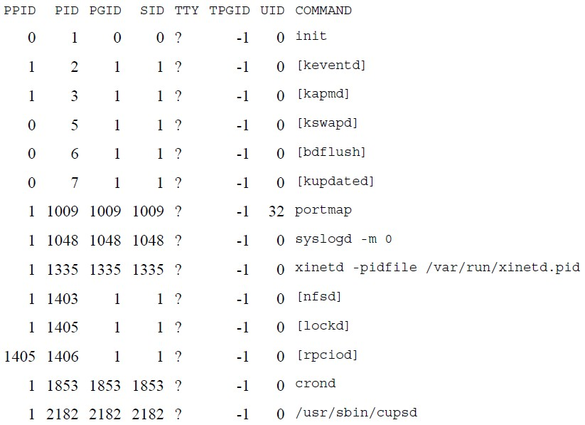
SIGNALS AND DAEMON PROCESSES
DAEMON PROCESSES
Deamon Characteristics
$ps -axj

Slide 51
SIGNALS AND DAEMON PROCESSES
DAEMON PROCESSES
Deamon Characteristics
Daemons run in background.
Daemons have super-user privilege.
Daemons don’t have controlling terminal.
Daemons are session and group leaders.

Slide 52
SIGNALS AND DAEMON PROCESSES
DAEMON PROCESSES
Deamon Characteristics
Anything with a parent process ID of 0 is usually a kernel process started as part of the system bootstrap procedure.
Kernel processes are special and generally exist for the entire lifetime of the system.
They run with superuser privileges and have no controlling terminal and no command line.
Process ID of 1 is usually init.
It is a system daemon responsible for, among other things, starting system services specific to various run levels.

Slide 53
SIGNALS AND DAEMON PROCESSES
DAEMON PROCESSES
Deamon Characteristics
keventd daemon provides process context for running scheduled functions in the kernel.
The kswapd daemon is also known as the pageout daemon.
It supports the virtual memory subsystem by writing dirty pages to disk slowly over time, so the pages can be reclaimed.
The inetd daemon (xinetd) listens on the system's network interfaces for incoming requests for various network servers.
The nfsd, lockd, and rpciod daemons provide support for the
Network File System (NFS).
The cron daemon (crond) executes commands at specified dates and times. Numerous system administration tasks are handled by having programs executed regularly by cron.
The cupsd daemon is a print spooler; it handles print requests on the system.

Slide 54
SIGNALS AND DAEMON PROCESSES
DAEMON PROCESSES CODING RULES
Call fork and have the parent exit. This does several things. First, if the daemon was started as a simple shell command, having the parent terminate makes the shell think that the command is done. Second, the child inherits the process group ID of the parent but gets a new process ID, so we're guaranteed that the child is not a process group leader.
Call umask to set the file mode creation mask to 0. The file mode creation mask that's inherited could be set to deny certain permissions. If the daemon process is going to create files, it may want to set specific permissions.

Slide 55
DAEMON PROCESSES SIGNALS AND DAEMON PROCESSES
CODING RULES
Call setsid to create a new session. The process (a) becomes a session leader of a new session, (b) becomes the process group leader of a new process group, and (c) has no controlling terminal.
Change the current working directory to the root directory. The current working directory inherited from the parent could be on a mounted file system. Since daemons normally exist until the system is rebooted, if the daemon stays on a mounted file system, that file system cannot be unmounted.
Unneeded file descriptors should be closed. This prevents the daemon from holding open any descriptors that it may have inherited from its parent.

Slide 56
SIGNALS AND DAEMON PROCESSES
DAEMON PROCESSES CODING RULES
6. Some daemons open file descriptors 0, 1, and 2 to /dev/null so that any library routines that try to read from standard input or write to standard output or standard error will have no effect.
Since the daemon is not associated with a terminal device, there is nowhere for output to be displayed; nor is there anywhere to receive input from an interactive user.
Even if the daemon was started from an interactive session, the daemon runs in the background, and the login session can terminate without affecting the daemon.
If other users log in on the same terminal device, we wouldn't want output from the daemon showing up on the terminal, and the users wouldn't expect their input to be read by the daemon.

Slide 57
#include <stdio.h>
#include <stdlib.h>
#include <unistd.h>
#include <sys/types.h>
#include <sys/stat.h>
int main(int argc, char* argv[])
{
FILE *fp= NULL;
pid_t process_id = 0;
pid_t sid = 0; // Create child process
process_id = fork(); // Indication of fork() failure
if (process_id < 0)
{
printf("fork failed!\n"); // Return failure in exit status
exit(1);
}
// PARENT PROCESS. Need to kill it.
if (process_id > 0)
{
printf("process_id of child process %d \n", process_id);
// return success in exit status
exit(0);
}
//unmask the file mode umask(0); //set new session
sid =setsid();
if(sid < 0)
{
// Return failure
exit(1);
}
signal(SIGHUP,SIG_IGN);

Slide 58
// Change the current working directory to root.
chdir("/");
// Close stdin. stdout and stderr
close(STDIN_FILENO);
close(STDOUT_FILENO);
close(STDERR_FILENO);
// Open a log file in write mode.
fp = fopen ("Log.txt", "w+");
while (1)
{
//Dont block context switches, let the process sleep for some time
sleep(1);
fprintf(fp, "Logging info...\n");
fflush(fp); // Implement and call some function that does core work for this daemon.
}
fclose(fp);
return (0);
}

Slide 59
SIGNALS AND DAEMON PROCESSES
DAEMON PROCESSES CODING RULES
Example Program:
#include <unistd,h> #include <sys/types.h> #include <fcntl.h> int daemon_initialise( ) { pid_t pid; if (( pid = fork() ) < 0) return –1; | else if ( pid != 0) exit(0); /* parent exits */ /* child continues */ setsid( ); chdir(“/”); umask(0); return 0; }

Slide 60
SIGNALS AND DAEMON PROCESSES
DAEMON PROCESSES
Error Logging
One problem a daemon has is how to handle error messages.
It can't simply write to standard error, since it shouldn't have a controlling terminal.
We don't want all the daemons writing to the console device, since on
many workstations, the console device runs a windowing system.
We also don't want each daemon writing its own error messages into a separate file.
A central daemon errorlogging facility is required.

Slide 61
1.SVR4 Streams log Driver::
SVR4 provides a streams device driver, with an interface for streams error logging, streams event tracing, and console logging.
Each log message can be routed to one of three loggers: the error logger, the trace logger, or the console logger.
There are three ways to generate log messages and three ways to read them.

Slide 62
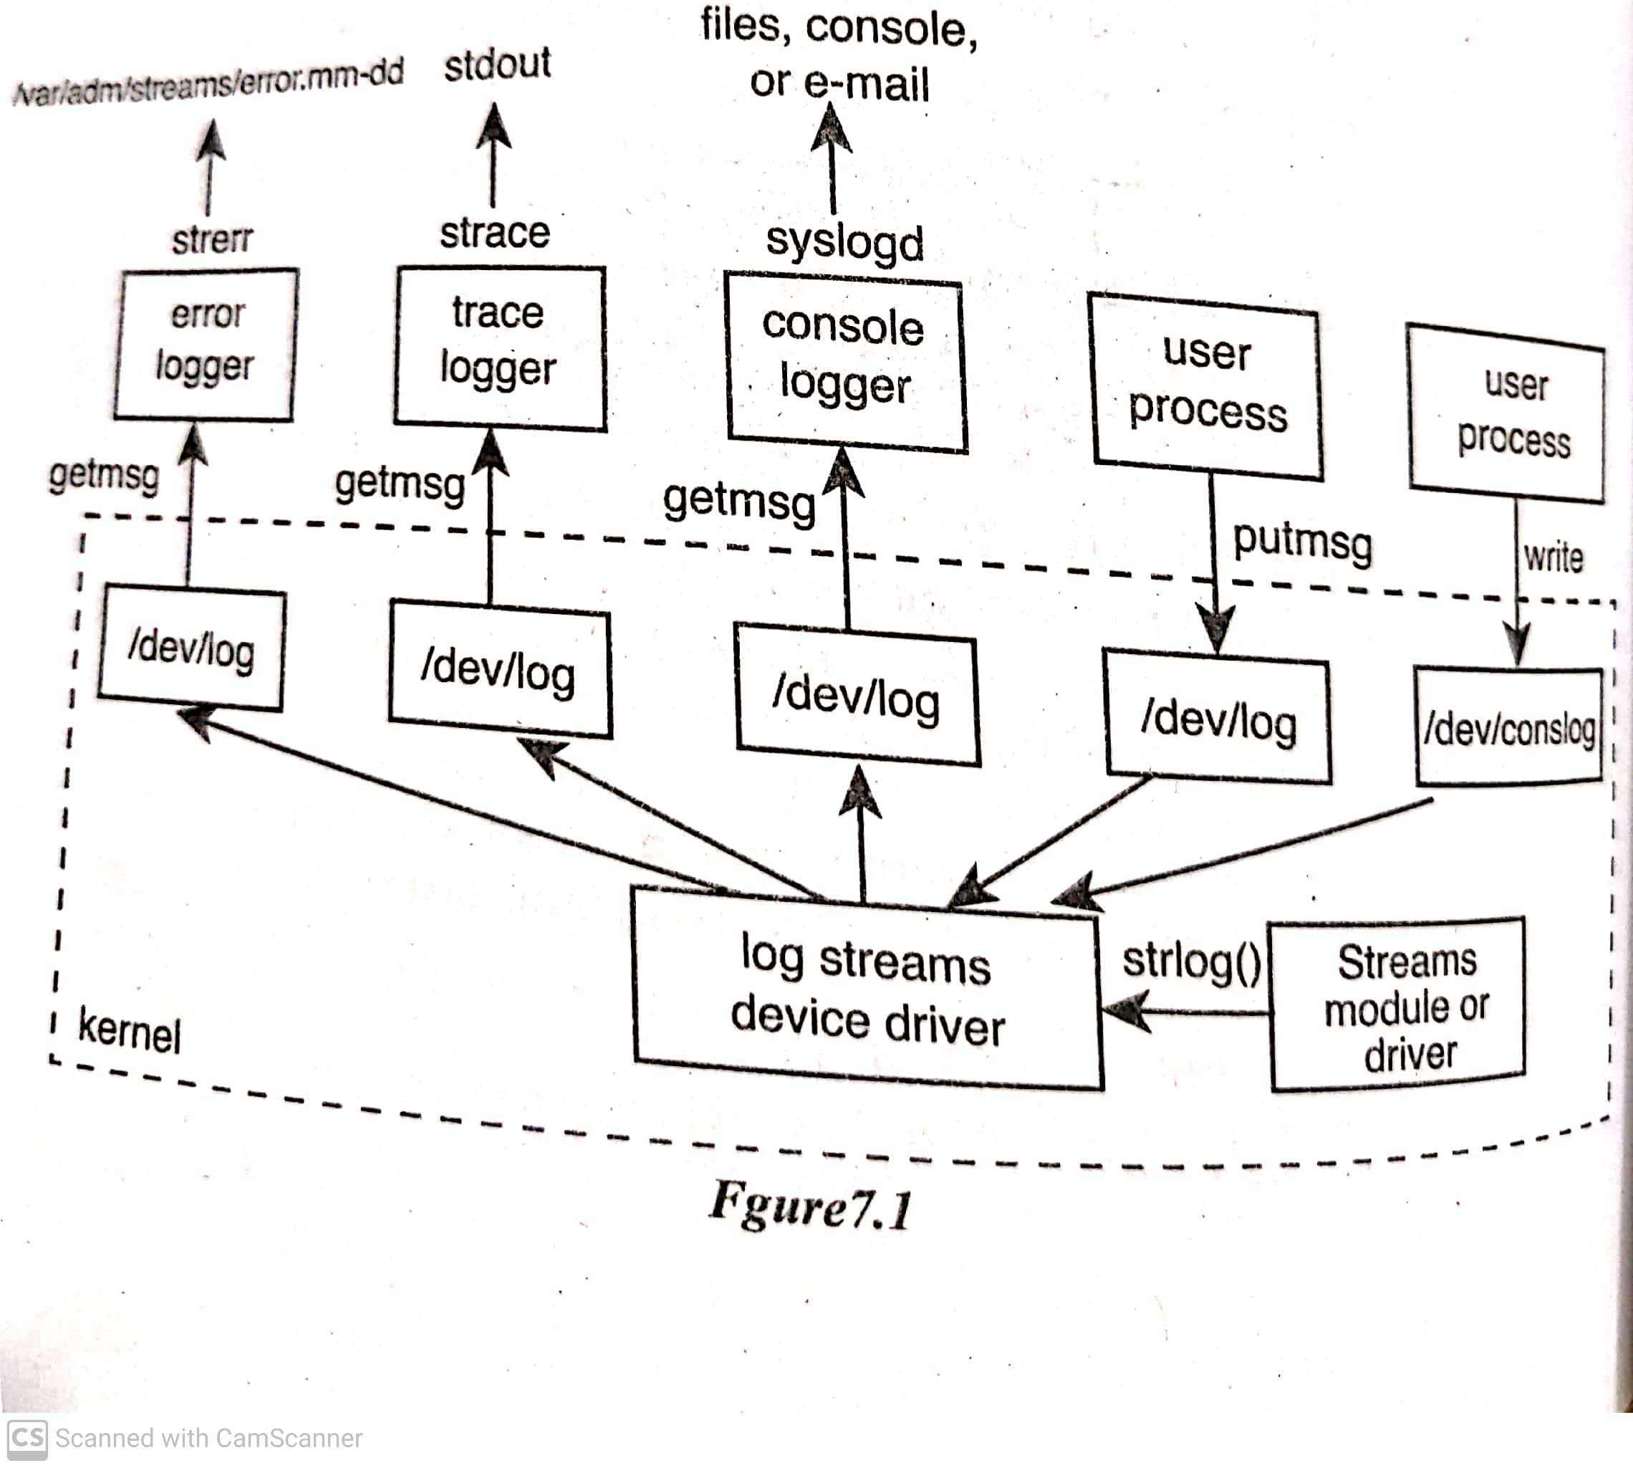
SIGNALS AND DAEMON PROCESSES
DAEMON PROCESSES
Error Logging SVR4 stream ‘log’ driver
290

Slide 63
Generating log messages:
Routines within the kernel can call strlog to generate log messages. This is normally used by streams modules and streams device drivers for either error messages or trace messages.
User processes (such as a daemon) can putmsg to /dev/log. This message can be sent to any of the three loggers.
A user process (such as a daemon) can write to /dev/conslog. This message is sent only to the console logger.

Slide 64
Reading log messages:
The normal error logger is strerr. It appends these messages to a file in the directory /var/adm/strearms. The file's name is error.mm-dd, where mm is the month and dd is the day of the month. This program, itself a daemon and it runs in the background, appending the log messages to the file.
The normal trace logger is strace. It can selectively write a specified set of trace messages to its standard output.
The standard console logger is syslogd. This program is a daemon that reads a configuration file and writes log messages to specified files or the console device or sends e-mail to certain users.

Slide 65
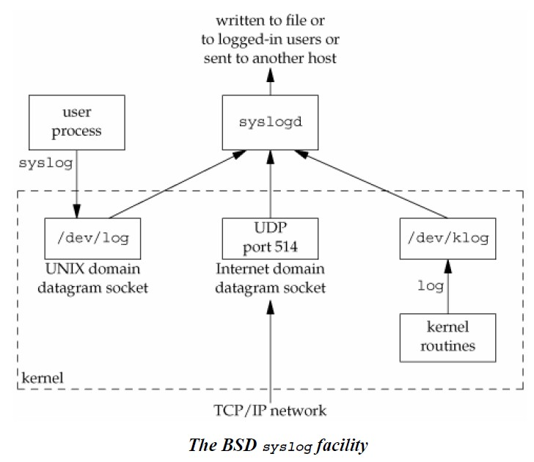
SIGNALS AND DAEMON PROCESSES
DAEMON PROCESSES
Error Logging 4.3+ BSD ‘ syslog( ) facility’
290

Slide 66
SIGNALS AND DAEMON PROCESSES
DAEMON PROCESSES
Error Logging
There are three ways to generate log messages:
Kernel routines can call the log function.
These messages can be read by any user process that opens and reads the
/dev/klog device.
Most user processes (daemons) call the syslog(3) function to generate log messages. This causes the message to be sent to the UNIX domain datagram socket /dev/log.
A user process on this host, or on some other host that is connected to this host by a TCP/IP network, can send log messages to UDP port 514.
The syslogd daemon reads all three forms of log messages.
On start-up, this daemon reads a configuration file, usually /etc/syslog.conf, which determines where different classes of messages are to be sent.
291

Slide 67
SIGNALS AND DAEMON PROCESSES
Client – Server Model
The most common use of a daemon process is as a server process.
In general, a server is a process that waits for a client to contact it, requesting some type of service.
e.g. inetd: is a server daemon, that listens on the system’s network interfaces for incoming requests for various network servers.
Syslogd: this service provides logging of an error messages.
Hence daemon processes are mainly used for client- server communication
291

Slide 68
SIGNALS AND DAEMON PROCESSES
Overview
What are daemons processes
Characteristics of daemon process
Coding rules for daemon
Error logging facility
SVR 4
4.3 BSD
Client – Server Model
291

